Slide 1
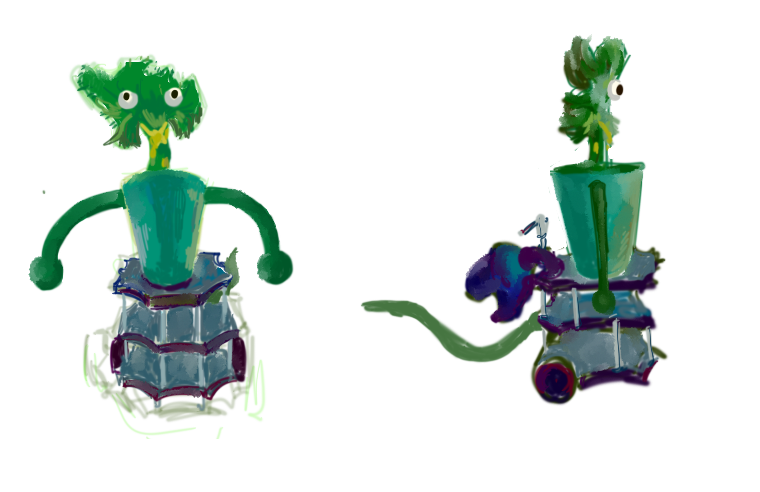
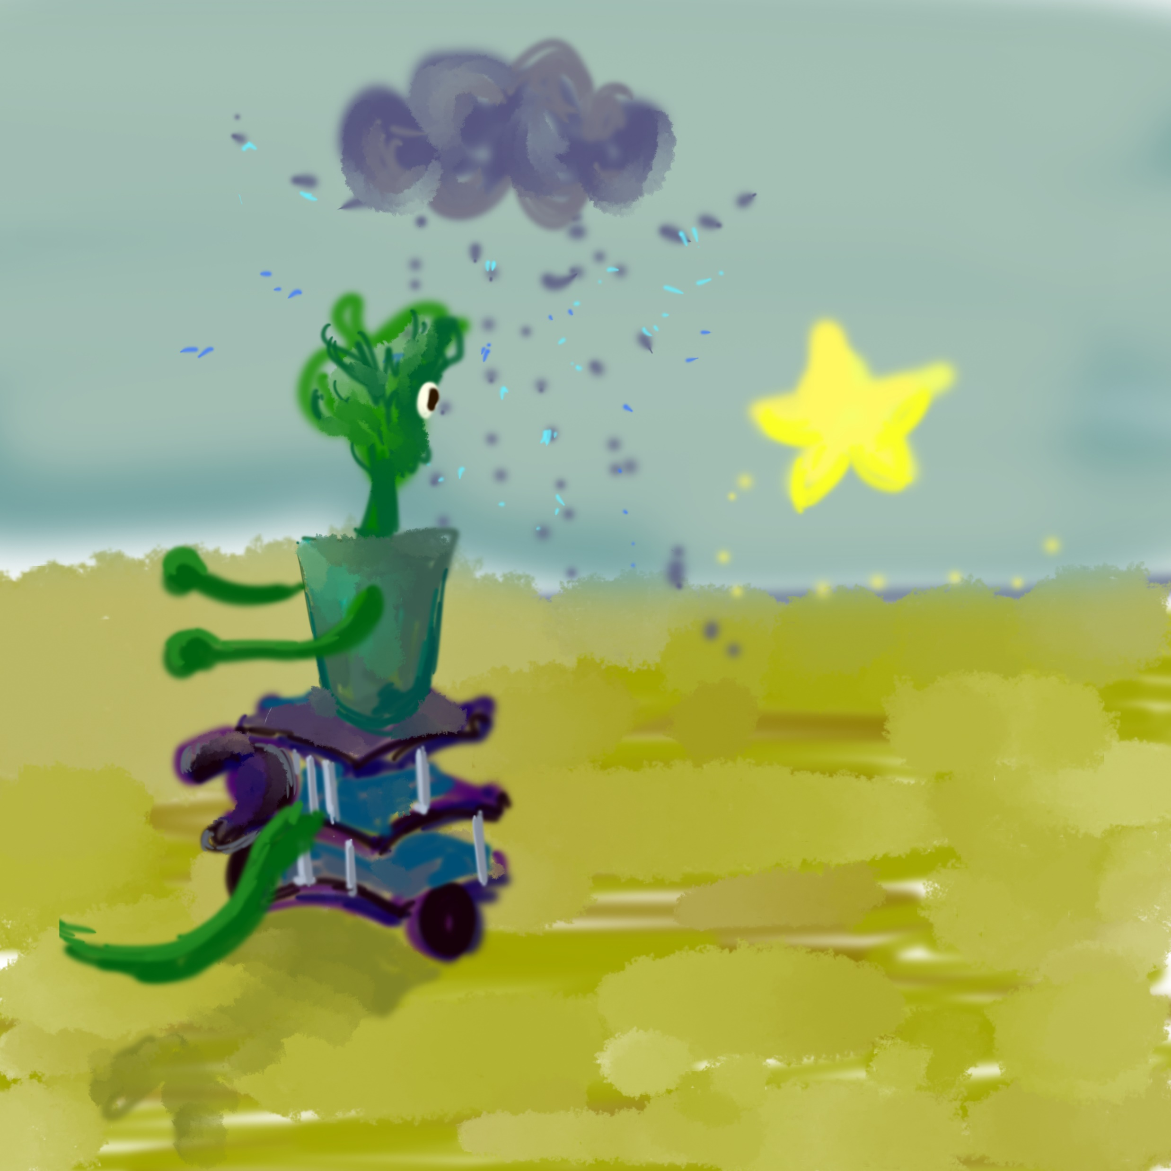
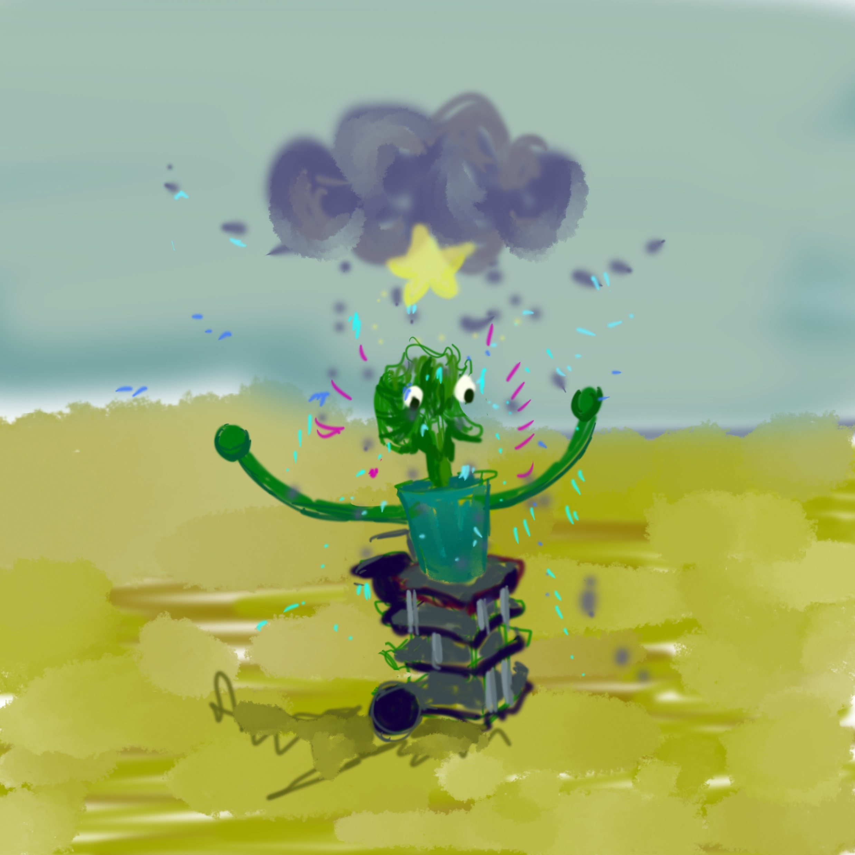

Slide 2
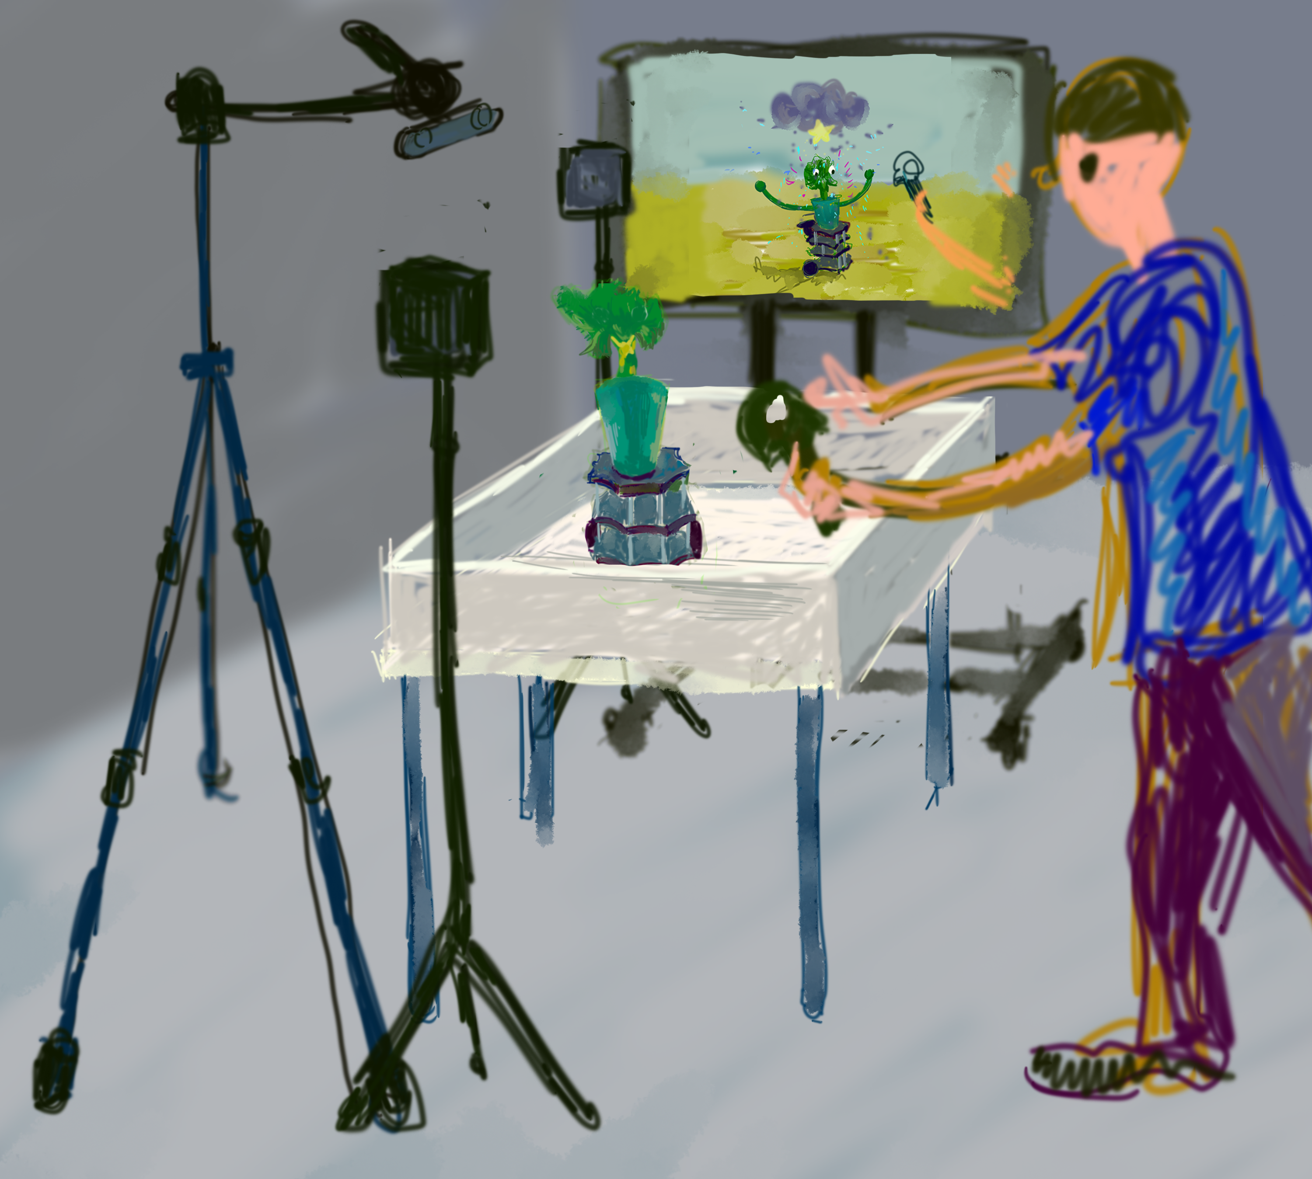

Slide 3
In 2500, there is a high civilization with many cyborgian agents, and also there is no border between physical and virtual space. Organisms living in this world supported by the robotic body, and most of them are extinct since there are not enough resources in the world……
Now, you are in 2500. The last plant in the world is in front of you. It looses its’ way to the rain, would you like to guide it to the raining area to save its’ life?

Slide 4
“The Last Cyborgian Plant” is my Capstone Project of my undergraduate study I am working on now, and it attempts to bring robotic elements to an organic plant, as well as to create a virtual body of the plant and synthetic environment. It is an excellent start to the objectives of my master's study, and it can be considered as an individual agent in my conceptual space. This project demonstrates how humans can interact with a hybrid object. Through hand tracking device(Leap Motion), people can grab the virtual star, and the physical plant will follow the moving of this virtual star. This project attempt to demonstrate how virtual elements and the physical object can be hybridized and bring human in the loop.

Slide 5
Capstone
Project
The Problem
Solution
The Last Plant in the World
Intelligence
Hybrid Virtual and Physical Object
Gap Between Virtual and Physical
Bridge them with IOT
Ambient Intelligence
Futurist
Extended Framework
Life 3.0
Hybrid Virtual and Physical Object
Cyborgian

Slide 6
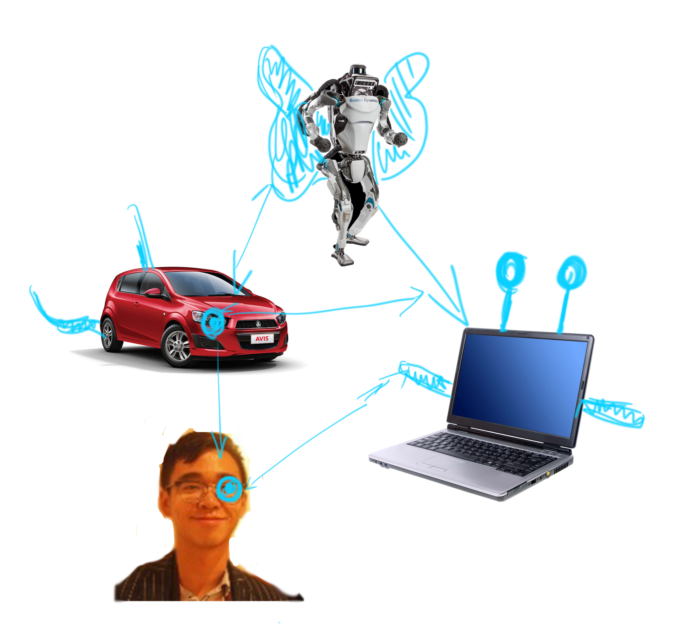
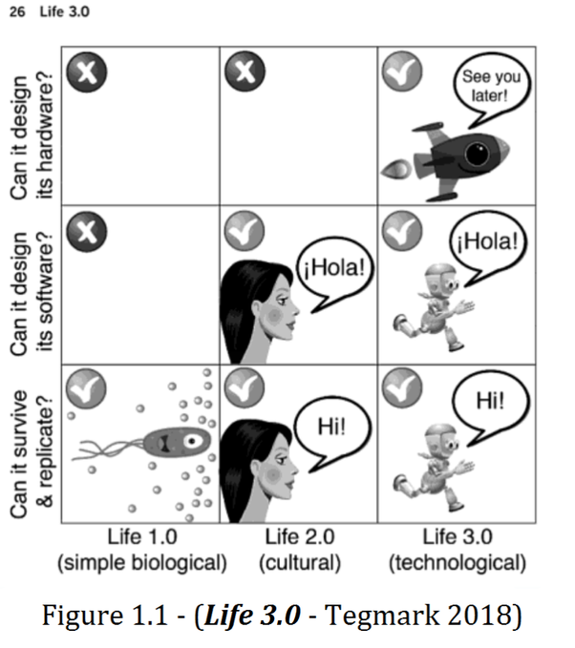
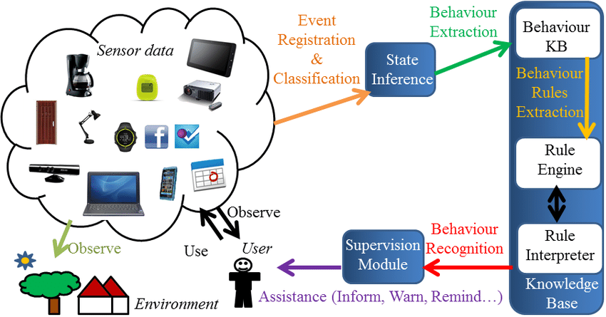
Visual Virtually Expansion
Ambient Intelligence
Ambient Intelligence as digital and proactive environments, with capacity to sense the environment and assist users in their daily lives.
Semantic and fuzzy modelling for human behaviour recognition in smart spaces: a case study on ambient assisted living

Slide 7
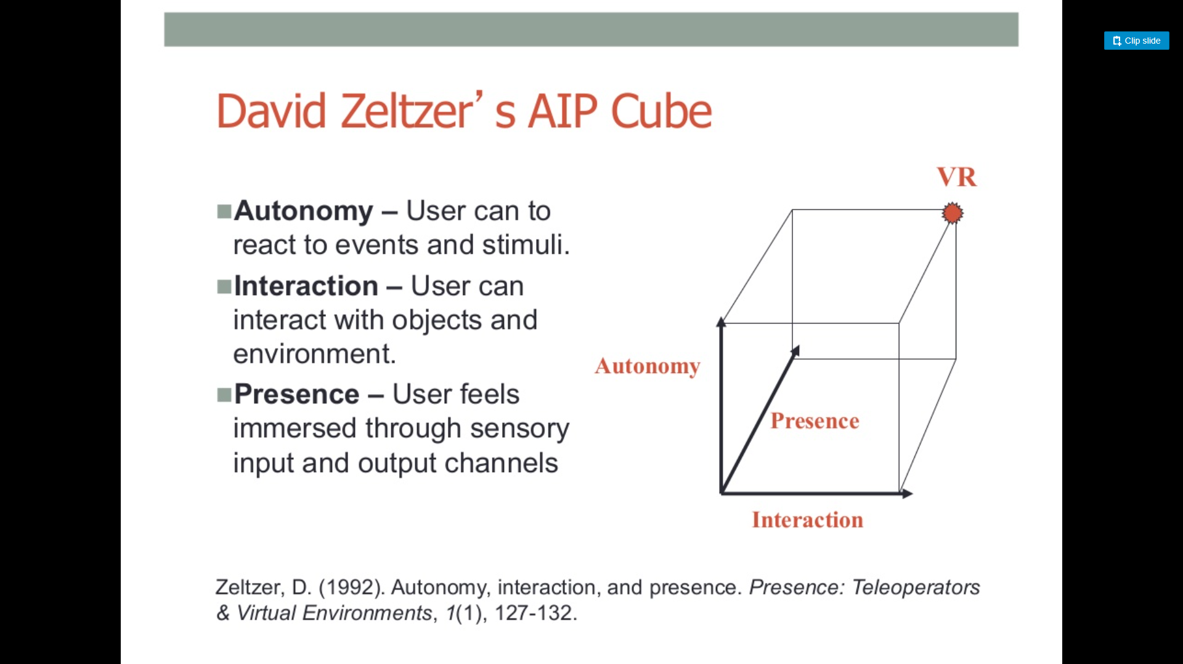

Slide 8
Last Plant in the World in 2500
Story
Do you want to help the plant to find the Rain
The Last Plant in the World
Box and Table
Setup
Plant, Robot, LED
The Unity system

Slide 9
A
C
C
B
State 1
State 2
State 3
A
B
B
A
State 1 – Rotate
State 2 – Go Straight
State 3 – Particle && LED Flash
A:Ray detect nothing
B:Ray detect cell
C:Body in water

Slide 10
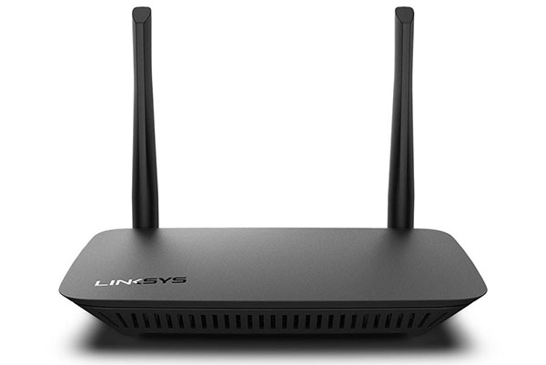
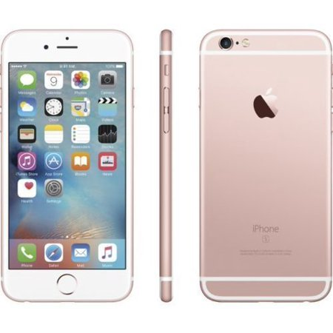
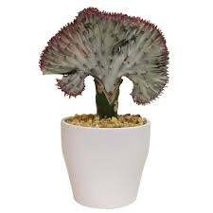
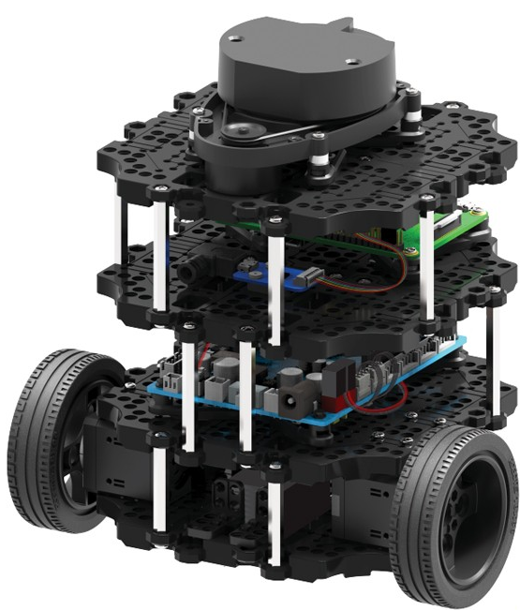
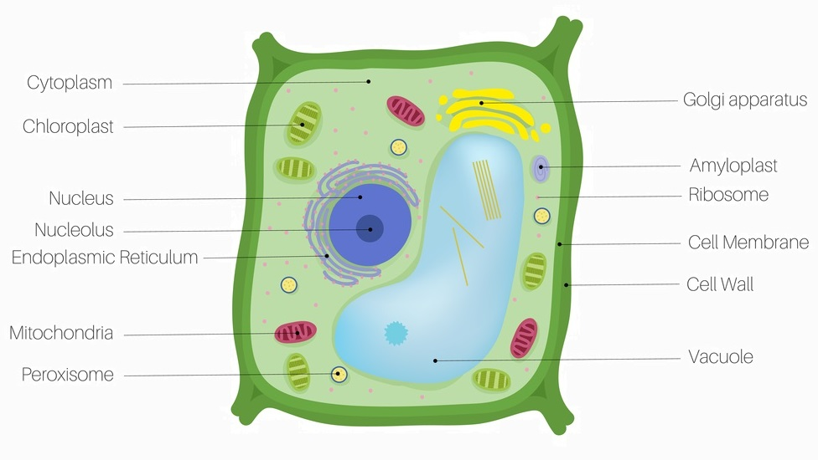
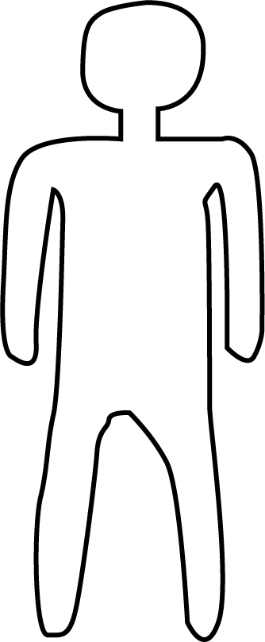
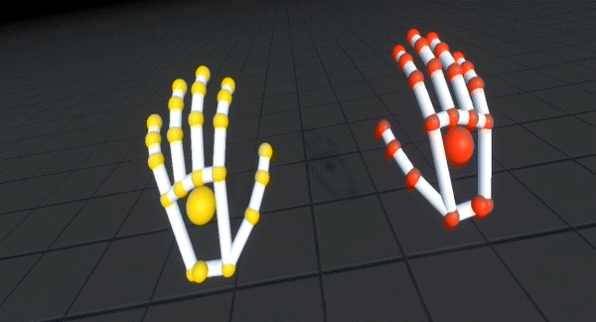
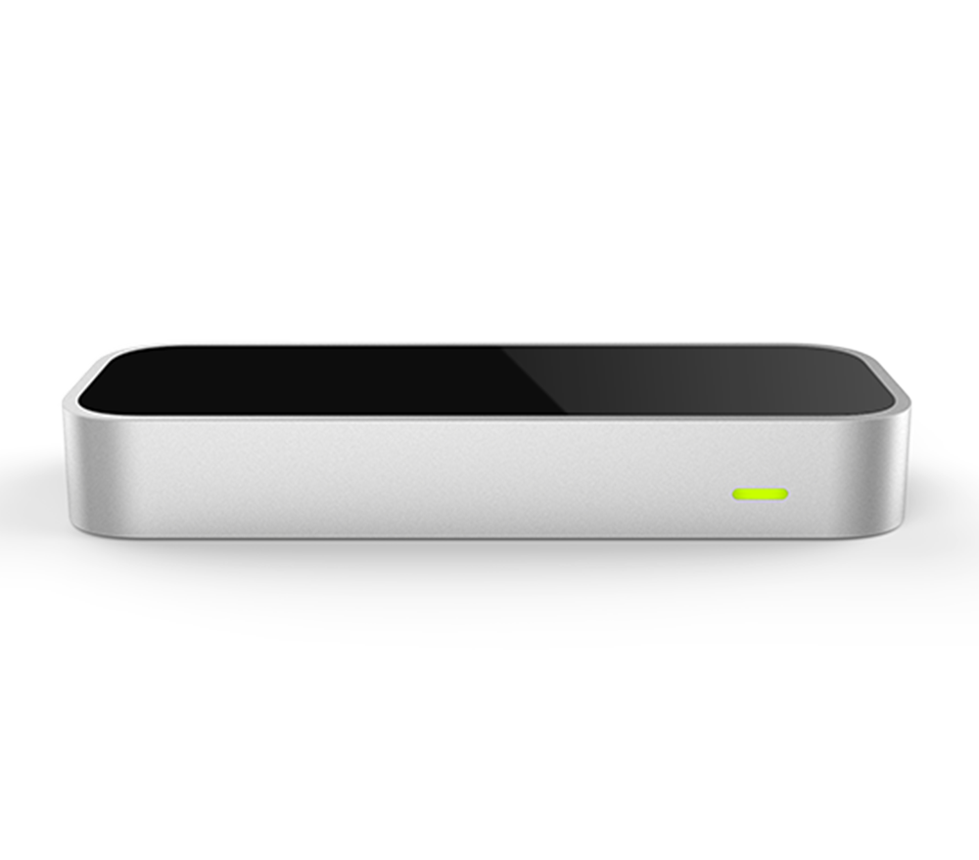
Vuforia Object Maker
Virtual Position
Physical Position
Roscore
Virtual Body
Turtlebot 3
Physical Body
Plant
Unity
Webcam
LED Strip
ESP8266
Ray Detection
Socket
Plant Cell
Human
Leap Motion
Virtual Hand

